Slide 1
Essential Oils and Sleep
Using essential oils to promote a good night of sleep
Notes:
For thousands of years, essential oils have been utilized for their calming and soothing properties. Anciently, calming oils were used for meditation, aromatherapy, and even things like religious ceremonies or rituals. The method of using essential oils to promote relaxing, calming feelings has remained popular throughout the years because essential oils provide a natural, yet effective way of calming the mind and body.
Because essential oils are so potent and powerful, they provide rather quick results, which makes them useful for promoting a good night of rest. Not only can essential oils with a calming or soothing nature help relax the body and mind before bed, but the comforting aroma of essential oils can also help create an environment that is conducive to sleep.

Slide 2
Sleep Deprivation Can Influence
Our ability to lose weight or maintain a healthy weight
Emotions and behaviors
Learning and motivation
The body’s organ systems and overall health
Reaction time and ability to drive safely
Notes:
We often worry about everything we should be doing during the day to maintain good health. We are concerned about getting regular exercise, having a healthy diet, managing our emotional health, and dozens of other factors that influence how we feel. However, we often neglect a major part of good health—getting good sleep. For most of us, busy work schedules, demands from our family, and endless to-do lists keep us from getting the rest we need.
While the amount of necessary sleep will vary from person to person, experts suggest that adults get between seven and eight hours of sleep per night. Many of us have the best intentions of getting adequate sleep, but it can be hard to get the mind and body to relax after a full day of stress or activity. You may think that the only consequences of losing sleep are feeling tired or cranky the next day; however, sleep deprivation can have a significant impact on our mental and physical health.
Without proper sleep, we put ourselves at risk for serious health issues that will impact our quality of life. Sleep deprivation:
Can make it difficult for us to lose weight or maintain a healthy weight
Can negatively influence our emotions and how we behave throughout the day
Can impact how we learn or influence our motivation levels
Can have a negative impact on nearly any of the body’s organ systems, which influences overall health
Can influence our reaction time and ability to drive safely (thousands of accidents are caused by drowsy drivers every year)
Just as sleep deprivation can negatively affect how we feel each day, getting quality sleep can help improve our quality of life.

Slide 3
Need Help Falling Asleep?
Maintain a healthy diet
Create a good sleeping environment
Avoid stimulants
Make sure you have adequate bedding
Exercise regularly
Remove distractions
Relax the body
Reset your internal clock
Use essential oils to create a restful sleeping environment
Notes:
For many people, improper sleep is a result of circumstances outside their control. It is difficult to get good rest when you are interrupted by a child or newborn several times throughout the night, have a job that requires you to work late, or a busy schedule that requires early mornings and late nights. However, if you have tried your best to get good, quality sleep and still feel like you can’t get your mind or body to quiet down, you might need a little extra help.
The suggestions on this slide can help those who might need extra help falling asleep or staying asleep at night. If you are having trouble sleeping, try a few of the following suggestions:
Do your best to eat healthy during the day.
Create an environment that will promote a good night of rest. Make sure it is dark, not too hot or cold, and quiet.
Try to avoid stimulants like alcohol, nicotine, and caffeine throughout the day, and especially before bed.
Make sure that you have adequate bedding. It might be time to buy a new mattress or pillows.
Follow a regular exercise routine. Make sure that you don’t exercise too close to bedtime, or your body might be too exhilarated to sleep.
Remove distractions from your bedroom, like technology and TV. Try to avoid screens for an hour before bed to help your eyes and mind relax.
Relax the body by taking a warm bath, or drinking a cup of tea (non-stimulating).
Reset your internal clock by going to bed and waking up at the same time every night and morning.
In addition to all of these methods, there are countless home remedies and unique approaches that claim to help with sleep. However, essential oils provide a simple yet effective way to create a relaxing environment and promote quality sleep. Each individual has different needs and preferences when it comes to sleeping, and the variety of essential oils allows the user to find an oil that works for them personally. When it comes to getting quality, consistent sleep, it is important to find what works best for calming and relaxing your body or mind before bed.

Slide 4
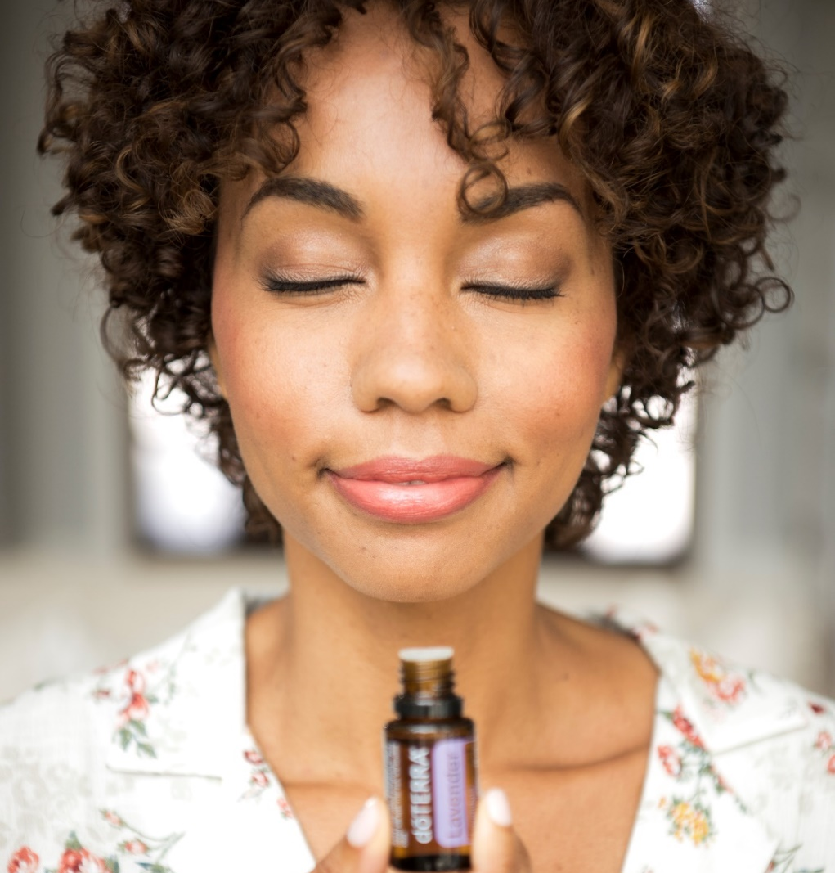
The Science Behind Essential Oils and Sleep
1. Inhale: Inhaling an essential oil can induce an internal response within the body for relaxation
2. Positive association: After a restful night of sleep, the aroma has now created a positive association within the brain
3. Sleep: This internal response can encourage a restful night of sleep
4. Repeat: Positive association promotes further use of this particular oil as part of a healthy sleeping routine
Notes:
So, what makes essential oils useful for sleep? How do they work? Well, every essential oil has a different chemical makeup with a unique combination of chemical constituents. These chemicals are what give an essential oil its benefits. Certain chemicals can make an essential oil useful for cleansing, soothing, or warming, while other chemicals might make an oil calming, invigorating, or cooling. Because each oil is taken from a different plant or plant part, each oil has a completely unique chemical profile, and thus a completely unique set of benefits.
By choosing essential oils with chemicals that hold relaxing, calming, or soothing benefits, it is easy to use oils to promote a peaceful environment for sleep.
Here’s how it works. When you inhale the aroma of an essential oil with calming properties, it can induce a response in the body or brain for relaxation. Typically, this type of reaction helps relax the body and promote a restful night of sleep. Once you’ve had a good night of sleep after using a specific oil, the brain makes a connection between the smell of the oil and the quality sleep. This is called a positive association. An established positive association promotes further use of the oil in your regular bedtime routine to help you repeat the practice of a good night’s sleep.

Slide 5
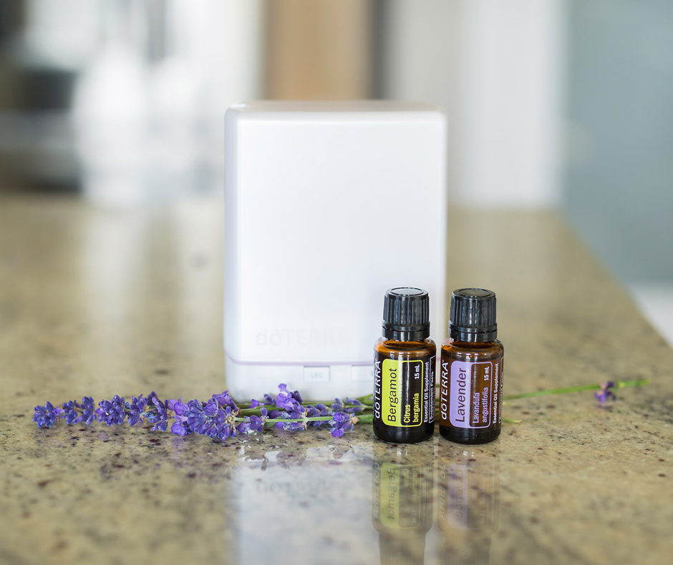
Which Essential Oils Can Help with Sleep?
Bergamot
Cedarwood
Chamomile
Cilantro
Clary Sage
Frankincense
Lavender
Serenity Blend
Marjoram
Melissa
Petitgrain
Roman Chamomile
Sandalwood
Thyme
Vetiver
Ylang Ylang
dōTERRA Peace®
Notes:
When using essential oils to promote a good night of sleep, it is best to choose oils with calming, soothing, or relaxing properties. The beauty of using essential oils to help with sleep is that there are a lot of oils with calming properties to choose from. Two people can have a different reaction to the same oil, so you can experiment to see which oils work best for you and your sleeping preferences.
The essential oils on this slide are some of the best oils to use to promote quality sleep because of their calming, soothing, relaxing, harmonizing, and grounding properties. You can also mix several oils together to create the optimal sleeping environment.
Discuss any oils on this slide that you have used for relaxation or sleep. Tell the audience which oils you like to use and why. Share any personal experiences that might help the audience when choosing their own oils to help with sleep and relaxation. If you need a little help, here are a few suggestions:
Cedarwood: The warm, woody scent of Cedarwood oil promotes a peaceful feeling that can help the mind and body unwind before bed.
Lavender: Commonly used for its calming properties, the light, floral aroma of Lavender oil makes it useful for creating an environment conducive for peaceful sleep
Ylang Ylang: The rich, floral aroma of Ylang Ylang oil can help reduce the effects of daily stress while promoting a calming environment.

Slide 6
How to Use Essential Oils to Promote Healthy Sleep
Diffusion
Warm bath or shower
Pillows and bedding
Heating pad or neck wrap
Topical application and massage
Tea
Notes:
In addition to a wide variety of oils to choose from, there are also many effective ways to use essential oils to promote a good night of sleep. As we discussed, you might need to experiment with a few different oils to find the best essential oil (or combination of oils) to help you fall asleep. You also might need to experiment with different application methods until you find the routine that works the best for you. This slide lists a few of the best ways to use essential oils in your bedtime routine. Let’s discuss each of these uses in more detail to help you fully utilize essential oils for relaxation and sleep.

Slide 7
Relaxing Diffuser Blends
3 drops Sandalwood 3 drops Vetiver 3 drops Lavender 2 drops Roman Chamomile
4 drops Lavender 3 drops Bergamot 2 drops Patchouli 2 drop Ylang Ylang
Notes:
If you are looking for an easy way to create a relaxing environment that will promote a good night’s sleep, you can simply place a few drops of a calming essential oil into an essential oil diffuser. The diffuser will disperse the scent of the oil around the room and create a calming, peaceful environment. Consider diffusing calming oils as you get ready for bed, or keep a diffuser in your bedroom to help maintain a relaxing environment throughout the night. With most diffusers, you can choose a time setting that will keep the diffuser running, which will help you remain relaxed.
You can mix several essential oils together to create your own unique diffuser blend for bedtime. Simply choose a few calming essential oils and mix them together to create a tranquil environment conducive to sleep. This slide lists a few diffuser blends that can help promote a restful environment. You can experiment with your favorite oils to find a blend that you like.
Share with the audience any of your tips for diffusing essential oils before bed. For example, you can tell the audience your favorite place to put your diffuser at night. You can also tell the audience about any of your favorite bedtime diffuser blends. Depending on the size of the group, you might consider printing out a diffuser blend recipe that the audience can take with them when they leave.

Slide 8
Warm Bath or Shower
Add a few drops of a calming oil to a warm bath before bed
Add essential oils to Epsom salt and pour into a warm bath
Place a few drops of essential oil of choice on the shower floor (away from the running water)
Add essential oils to your shampoo or conditioner
Notes:
Taking a relaxing bath or warm shower might be a part of your regular bedtime routine; however, throwing essential oils into the mix might help calm the body and mind, promoting a better night of sleep. Consider adding a few drops of your favorite calming oil to a warm bath, or mix essential oils with Epsom salts before adding them to the bath to soothe the skin and the body.
By placing a few drops of an oil on the floor of the shower, the oil will mix with the steam and allow you to breathe in the calming, comforting scents. Just be sure to place the oil away from the water path to make sure it doesn’t get washed down the drain immediately. You can also keep the relaxing scents of essential oils with you throughout the night by placing a few drops of oil into your conditioner and applying to your hair in your nightly shower. Calming oils like Clary Sage, Ylang Ylang, and Lavender not only have relaxing properties, but can also be beautifying for your hair.
Share with the audience any of your favorite uses for essential oils when bathing or showering that could help them get ready for a good night of sleep.

Slide 9
Pillows and Bedding
Add a few drops of a calming essential oil to a spray bottle and mix with a few ounces of water. Use the spray bottle to spritz the mixture over your pillows and bedding before going to sleep to create a restful environment.
Lavender + Cedarwood Bergamot + Vetiver Sandalwood + Ylang Ylang
Notes:
As discussed, having the proper pillows, bedding, and mattress are key to a good night of sleep. If you’ve already invested in new pillows or a better mattress and still find it difficult to get good rest, consider spritzing essential oils over your pillows and bedding before going to sleep. Simply combine a few drops of a relaxing essential oil (or oils) and a few ounces of water in a spray bottle. Then, spritz the mixture over your pillows and bedding so that you can inhale the calming and comforting scents of essential oils throughout the night. This slide shows a few essential oil combinations that are perfect for spritzing over your bedding.

Slide 10
Heating Pad or Neck Wrap
Materials Needed:
Kitchen towel
Sewing machine
6 cups flaxseed or rice
dōTERRA® essential oil(s)
Directions:
Fold towel in half long-ways (hot-dog style).
Sew around the edges leaving a three-inch opening at the top. Turn right side out.
Loosely fill with flax seeds or rice.
Sew opening closed, and you’re done!
To use, microwave for two to three minutes and add two drops of essential oil on the outer fabric.
Notes:
Just as taking a warm bath or shower before bed can soothe and comfort the body, using a heating pad or neck wrap is a good practice when preparing for bed. You can harness the calming power of essential oils by simply adding a few drops of an essential oil to the outside fabric of a heating pad or neck wrap, and place on the neck or back for warming comfort. It is also easy to make your own neck wrap with a kitchen towel and rice or flaxseed, as shown by the DIY on this slide.
Discuss the DIY on this slide with the audience. Consider printing off the DIY to send home with audience members so they can try it on their own. Warn the audience that after microwaving the heating pad it will be very warm and can burn the skin if it gets too hot. Consider making your own heating pad and using it as a prop to show the audience what it looks like.

Slide 11
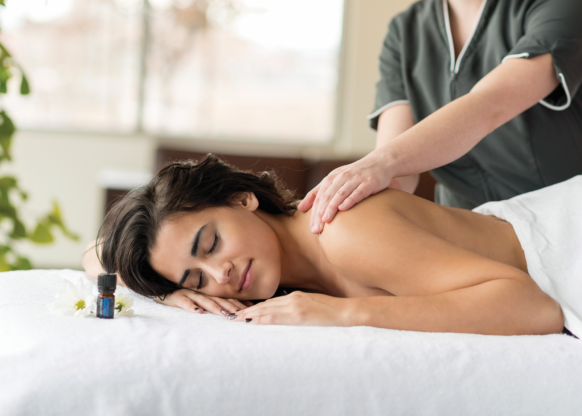
Topical Application and Massage
Bottoms of the feet
Neck and shoulders
Temples
Wrists
Massage: shoulders, arms, back, legs, feet
Notes:
Applying essential oils topically is a very effective way to prepare the body for a good night of sleep by creating a calm environment. As you apply oils to the skin, the aroma will linger for an extended period of time, allowing you to remain calm and relaxed. The bottom of the feet is one of the best places to apply essential oils before going to bed. The skin is very thick on the bottom of the feet, so it is less likely to cause irritation, but you will still be able to enjoy the aroma. The neck and shoulders, temples, and wrists are also good places to apply calming oils topically before going to bed.
In addition to topical application, using calming or relaxing oils for massage before bed is a wonderful way to relax the body and mind. Massaging the shoulders, arms, back, legs, and feet with essential oils will not only put the body at ease, but will allow you to inhale the comforting aroma of essential oils at the same time.
Remember, it is a good idea to dilute essential oils with a carrier oil like dōTERRA® Fractionated Coconut Oil before applying topically to help avoid any irritation. Using a carrier oil will help the essential oils absorb into the skin, which helps the benefits and the scent of the oil to last a little longer. It is important to always use a carrier oil when applying oils to young or sensitive skin, so be sure to have a carrier oil on hand when applying oils to your children.
Share any tips with the audience about topical application or massage. Tell the audience about any of your favorite essential oils to apply topically before bed.

Slide 12
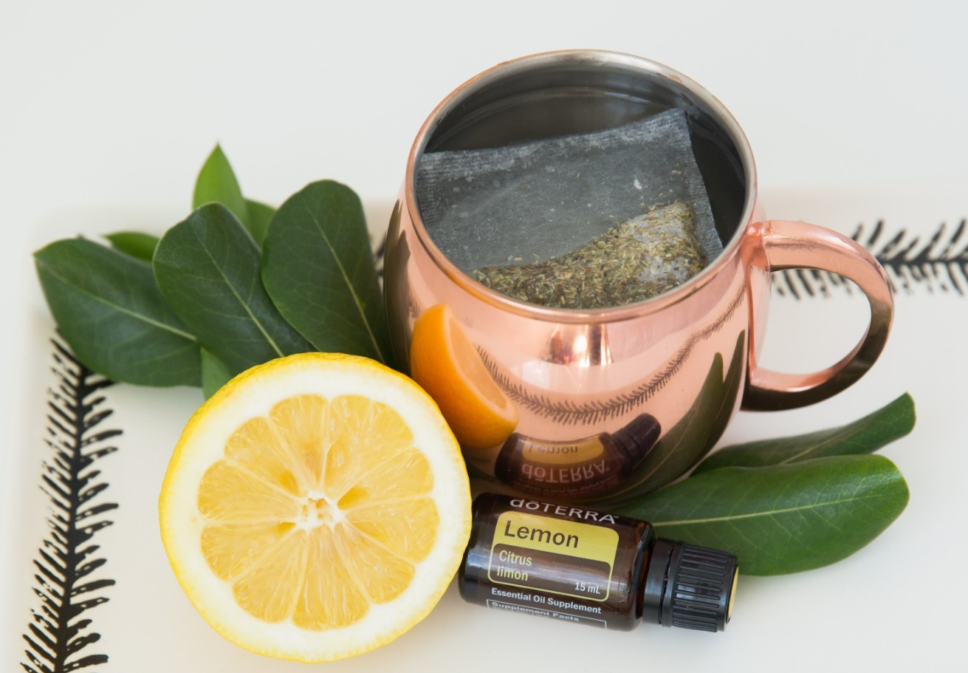
Warm Teas
Non-caffeinated, non-stimulatory
Herbal teas: chamomile, lavender, honey-lemon
Notes:
A warm cup of tea before bed is a tried and true sleep solution; however, adding essential oils to your bedtime tea can provide a unique relaxing experience. First, you will want to make sure the tea you are drinking is not caffeinated since these types of tea could keep you awake. Essential oils work well with herbal teas, and chamomile tea is a great choice for relaxing the body and mind. You can also add Bergamot oil to your tea when you want to turn it into Earl Grey.
Before adding any essential oils to your tea, you will want to make sure that the oil has been approved for internal consumption. dōTERRA uses the letters “A”, “T”, and “I” when describing application methods for oils. “A” means the oil is safe for aromatic use, “T” stands for topical use, and “I” stands for internal use. Once you have checked that the oil is safe for internal use, you can add a drop to your tea. Because essential oils are so potent, you won’t need very much oil to add a big boost of flavor to your beverage.
Share with the audience some of your favorite essential oils to add to tea before bed. If you plan to give away oil samples after the class, you might consider attaching a dōTERRA® oil sample to a package of tea so that the audience members can try it when they get home.

Slide 13
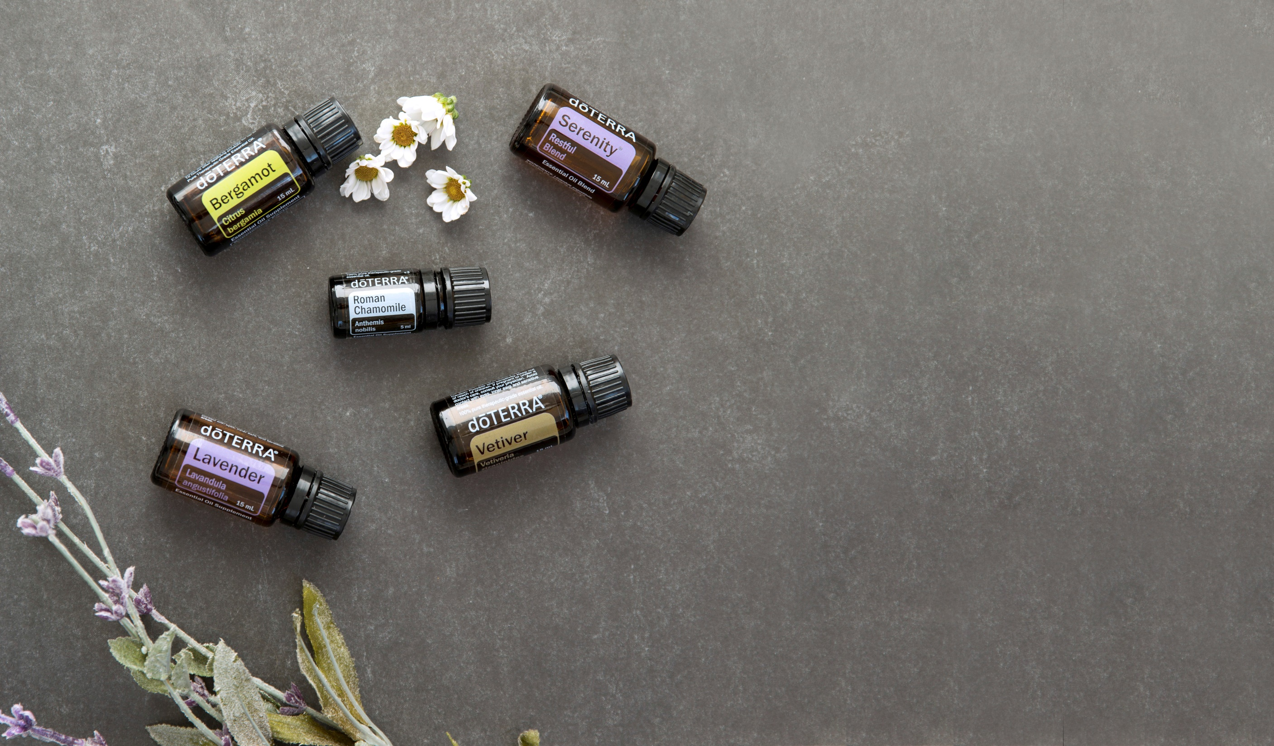
®
®
dōTERRA Products for Sleep and Relaxation
Notes:
In addition to the application methods we have discussed, dōTERRA has designed a few products that can be useful when trying to promote a good night of sleep. These products make it even easier to enjoy the benefits that essential oils hold for rest and relaxation.

Slide 14
®
dōTERRA Diffusers
Aroma Lite
Lotus
Petal
Lumo™
Notes:
Like we talked about, one of the easiest ways to use essential oils for promoting quality sleep is diffusion. Not only are essential oil diffusers useful for creating a relaxing environment for sleep, but they can also be used for dozens of other purposes and allow you to create any kind of atmosphere you like. If you don’t have an essential oil diffuser, consider one of the several models that dōTERRA offers to help enhance your essential oil experience.
Share any personal experiences you have had with essential oil diffusers that will help the audience understand the benefits of using a diffuser. For example, talk about what kind of diffuser you like to use, and what you use your diffuser for. If you have any experience with using an essential oil diffuser to promote better sleep, share the experience with the audience.

Slide 15
dōTERRA Balance
Grounding Blend
®
Promotes a whole-body sense of relaxation
Evokes feelings of tranquility and balance
Use dōTERRA Balance to promote a restful environment by:
Adding a few drops to your diffuser
Applying to neck or bottoms of feet
Use during a massage before bed
Notes:
In addition to the single oils that we discussed, dōTERRA® has several proprietary essential oil blends that can help create a relaxing environment for sleep.
The dōTERRA Balance® Grounding Blend is a blend of essential oils and plant extracts that can help to naturally promote relaxation, and, as you probably guessed, create feelings of balance. dōTERRA Balance is an optimal blend to use before going to bed because it can promote feelings of peace and tranquility, while providing the body with a sense of relaxation. Consider placing a few drops of dōTERRA Balance in your essential oil diffuser, applying the blend topically to the neck or bottoms of the feet, or using in a massage before bed.
If you’ve had any positive experiences with dōTERRA Balance, share them with the audience. If you have a bottle of dōTERRA Balance, you can pass the bottle around for the audience to smell.

Slide 16
dōTERRA Breathe Respiratory Blend
®
Maintains feelings of clear airways
Promotes a restful night’s sleep
Use dōTERRA Breathe to promote quality sleep by:
Applying topically to the chest, back, or bottoms of the feet
Diffusing at nighttime
Notes:
dōTERRA Breathe® Respiratory Blend is another essential oil blend that can help prepare you for a peaceful night of sleep. dōTERRA Breathe combines essential oils like Peppermint, Eucalyptus, Melaleuca, Cardamom, and Lemon to help the user maintain feelings of clear airways. The fresh aroma of this oil blend can help calm the senses and promote a restful night of sleep. To enjoy the benefits of dōTERRA Breathe at night, you can add a few drops to an essential oil diffuser, or apply the oil topically to the chest, back, or bottoms of the feet. To avoid sensitivity, dilute dōTERRA Breathe with a carrier oil like dōTERRA® Fractionated Coconut Oil before applying topically to the skin.
If you’ve had any positive experiences with dōTERRA Breathe, share them with the audience. If you have a bottle of dōTERRA Breathe, you can pass the bottle around for the audience to smell.

Slide 17
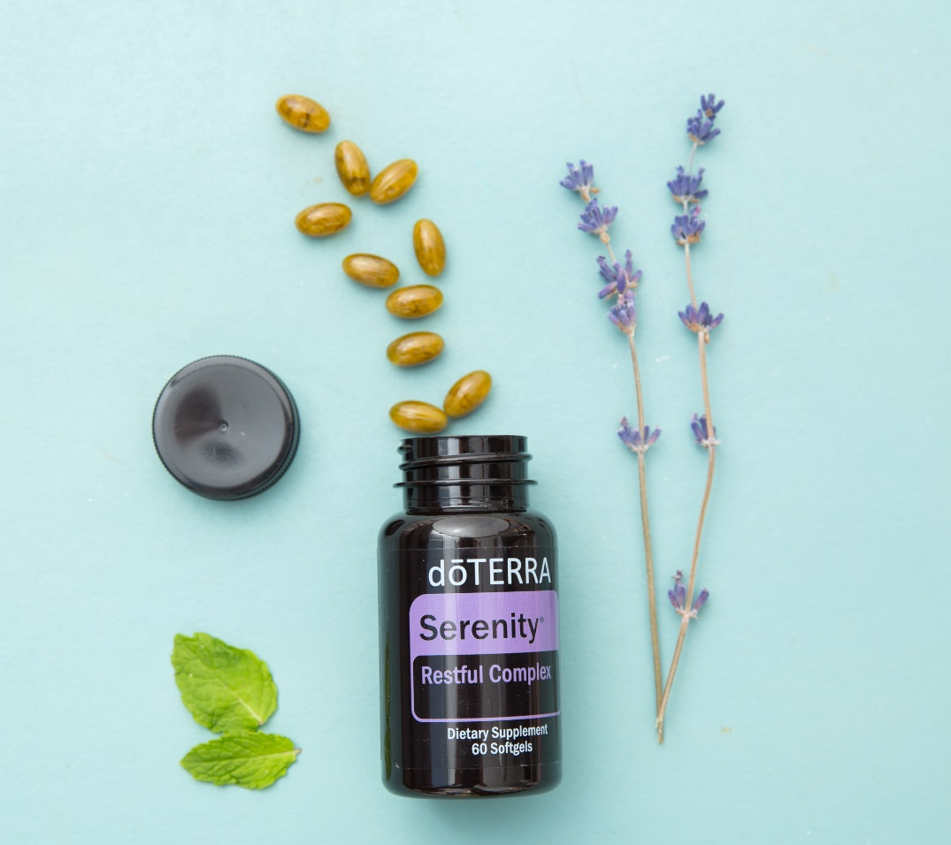
dōTERRA Serenity
Restful Blend
®
Promotes relaxation and a restful sleeping environment
Lessens feelings of tension, calms emotions, soothes senses
Use dōTERRA Serenity Restful Blend to create a restful sleeping environment by:
Placing a few drops in your essential oil diffuser
Applying to the chest, bottoms of the feet, back of the neck, or inhale directly from the palms
Adding a few drops to a warm bath before bed
Using in conjunction with dōTERRA Serenity®
Notes:
dōTERRA has also created a specially formulated essential oil blend called the dōTERRA Serenity® Restful Blend, designed to promote relaxation and help calm the emotions and body before bed. You can easily enjoy the calming benefits of the dōTERRA Serenity blend by diffusing the oil, applying it topically, or adding it to a warm bath.
In addition to the dōTERRA Serenity Restful Blend, dōTERRA has created the dōTERRA Serenity™ Restful Complex Softgels for when you need a little extra help falling or staying asleep. The dōTERRA Serenity Restful Complex Softgels combine Lavender oil and natural plant extracts to encourage restful sleep.* The formula is designed to help you get a refreshing night of sleep without feeling sleepy the next day.
* These statements have not been evaluated by the Food and Drug Administration. This product is not intended to diagnose, treat, cure, or prevent any disease.
The dōTERRA Serenity Restful Blend is also used to create the dōTERRA® SPA Serenity Bath Bar—a luxurious, moisturizing bath bar that can help you unwind and get ready for bed. Not only will you get to enjoy the lovely, inviting scent of dōTERRA Serenity® as you use the bath bar, but the aroma will also help promote relaxation before bedtime. Use the dōTERRA Serenity bath bar during your bath or shower before bed, and enjoy the calming, purifying, and relaxing benefits of this product.
If you’ve had any positive experiences with dōTERRA Serenity Restful Blend, dōTERRA Serenity Restful Complex Softgels, or dōTERRA SPA Serenity Bath Bar, share them with the audience. If you have a bottle of dōTERRA Serenity, you can pass the bottle around for the audience to smell.

Slide 18
Notes:
Now is a good time to ask the audience if they have any questions. You will also want to give them your contact information, and any important information about ordering dōTERRA® products from you, or joining your dōTERRA team.
Additional Resources:
https://www.doterra.com/US/en/brochures-magazines-doterra-living-fall-2015-sleep-what-many-of-us-are-missing
https://www.doterra.com/US/en/blog/science-for-kids-sleep
https://www.doterra.com/US/en/blog/science-wellness-sleep-deprivation-junk-food
https://www.doterra.com/US/en/brochures-magazines-doterra-living-fall-2016-sleep-effects
https://www.doterra.com/US/en/blog/healthy-living-sleep-what-many-of-us-are-missing

